Slide 1
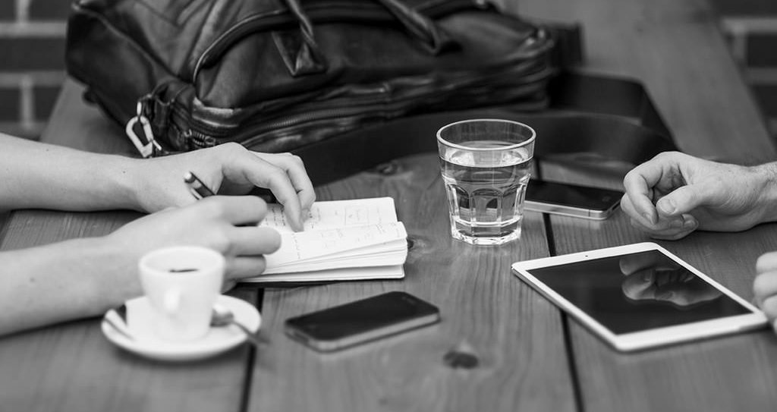
Snapchat:
Let’s start using it seriously

Slide 2
HEY Y’ALL!
Samantha Ragland
Manager, Digital Entertainment Strategy, @pbpost
Find me! @sammyragland
Follow our snap-scapades! @postnow

Slide 3
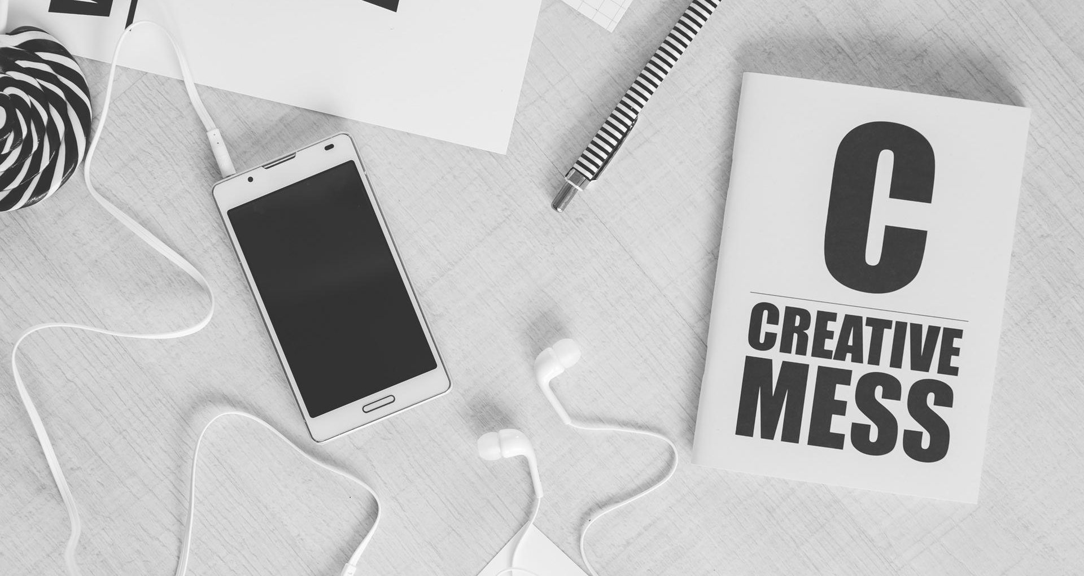
RESPECT THE SNAP GAME
Style matters. So does strategy.
@sammyragland #ONASouthFlorida

Slide 4
Here’s the deal...
Know what you know
Keep the 4 c’s in mind
Pay the right attention
Practice before you preach
@sammyragland #ONASouthFlorida

Slide 5
How to become a subject expert
AKA, know what you know
@sammyragland #ONASouthFlorida

Slide 6
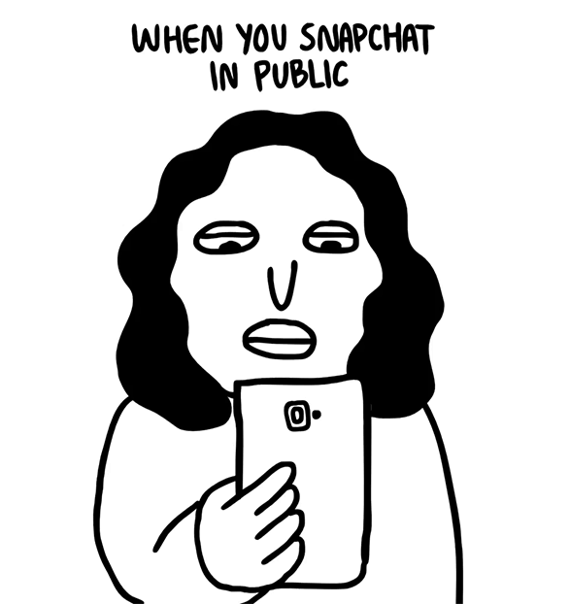
THE RIGHT PERSON →
The shortest distance between “casual snapper” and “expert snapper” starts with unapologetic public use.
@sammyragland #ONASouthFlorida

Slide 7
Become an expert
Commit time to exploring and experimenting
Create translations of traditional stories, experiences
Pitch exclusive stories that put audience first
Develop best practices and brand style guide
Train staff, starting with the curious
Build and engage with audience
@sammyragland #ONASouthFlorida

Slide 8
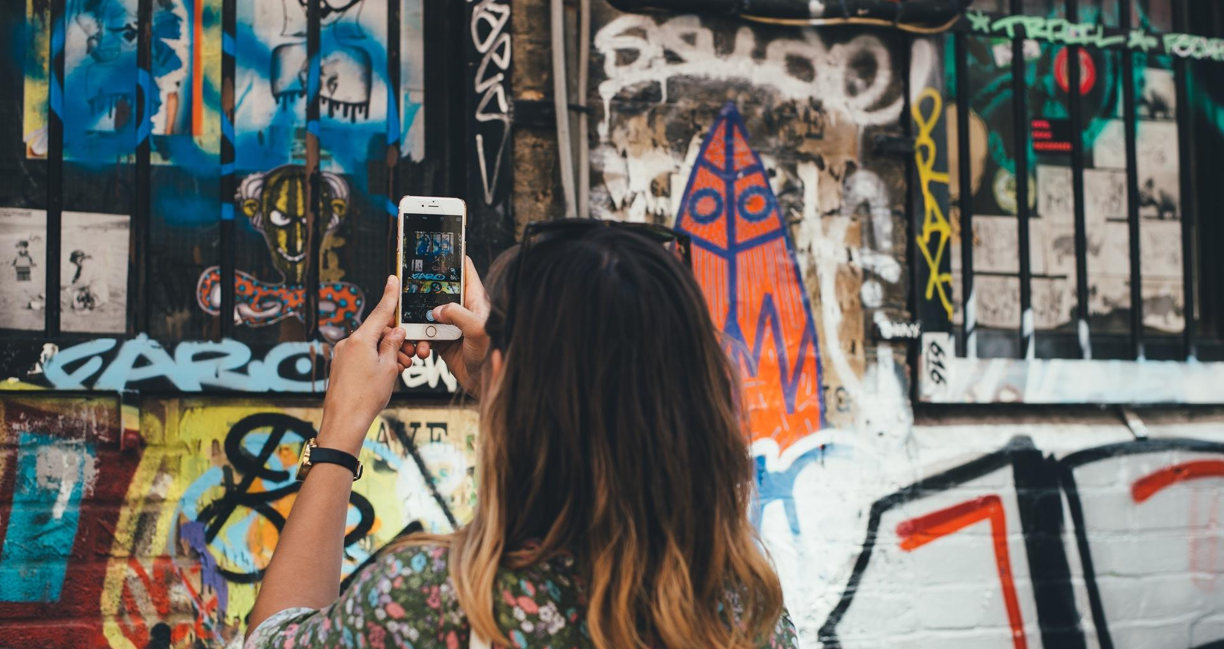
2. Learn to love the creative mess
Aka, keep the 4 c’s in mind
@sammyragland #ONASouthFlorida

Slide 9
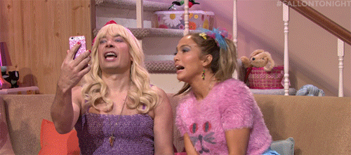
ASK YOURSELF
Can this platform be more than just…?
Yes.
@sammyragland #ONASouthFlorida

Slide 10
Say Hello
The 4 C’s of Snapchatting like a boss
@sammyragland #ONASouthFlorida

Slide 11
Capitalize on opportunities
@sammyragland #ONASouthFlorida

Slide 12
Consider special access

Slide 13
Copy the masters
@sammyragland #ONASouthFlorida

Slide 14
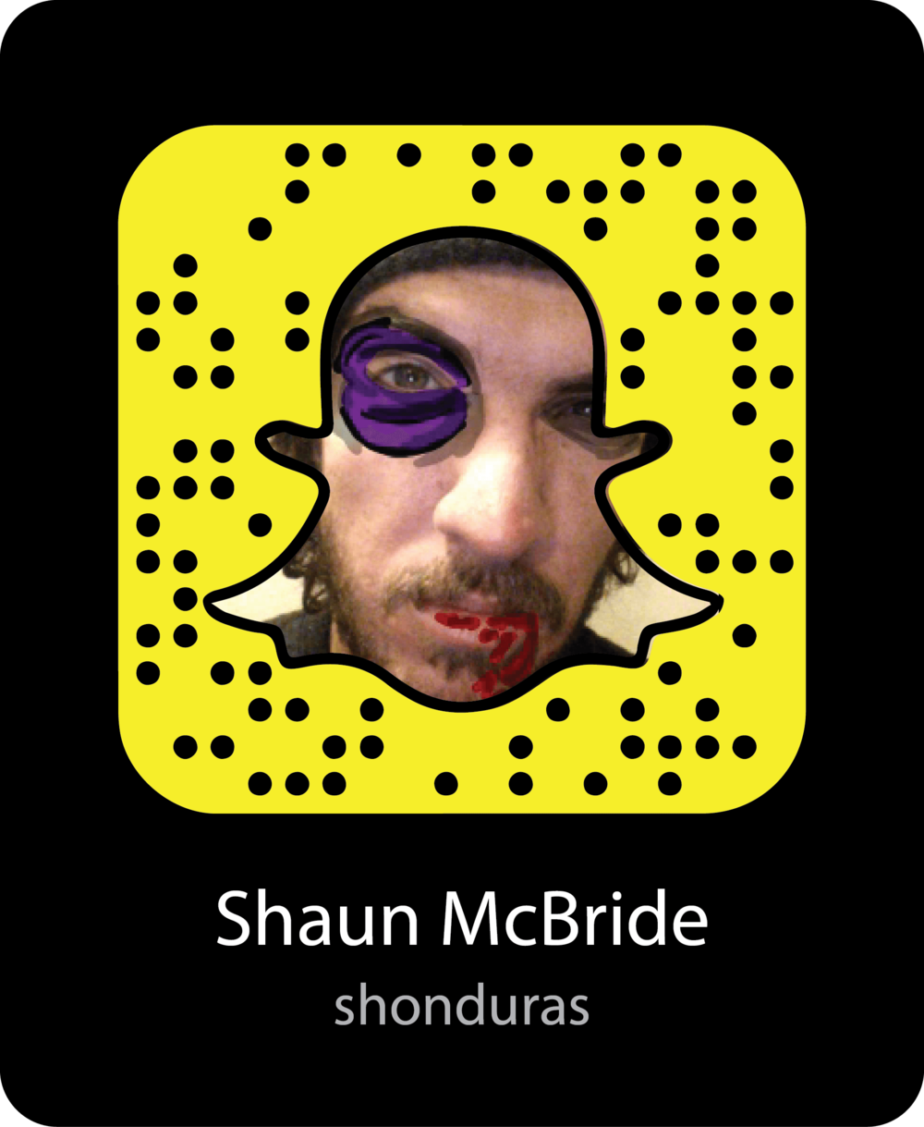
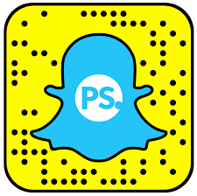
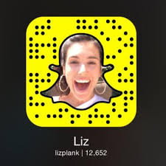
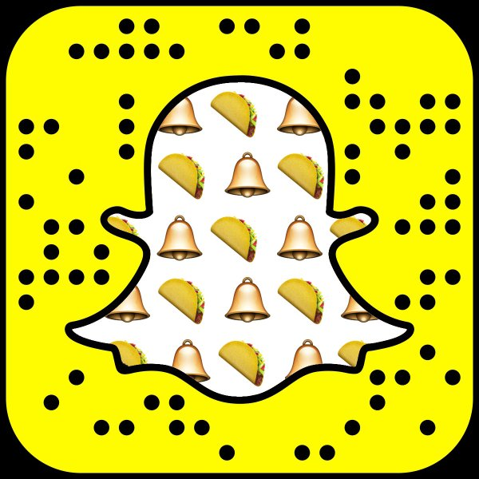
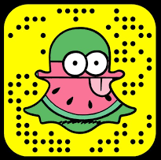
These are some of the masters

Slide 15
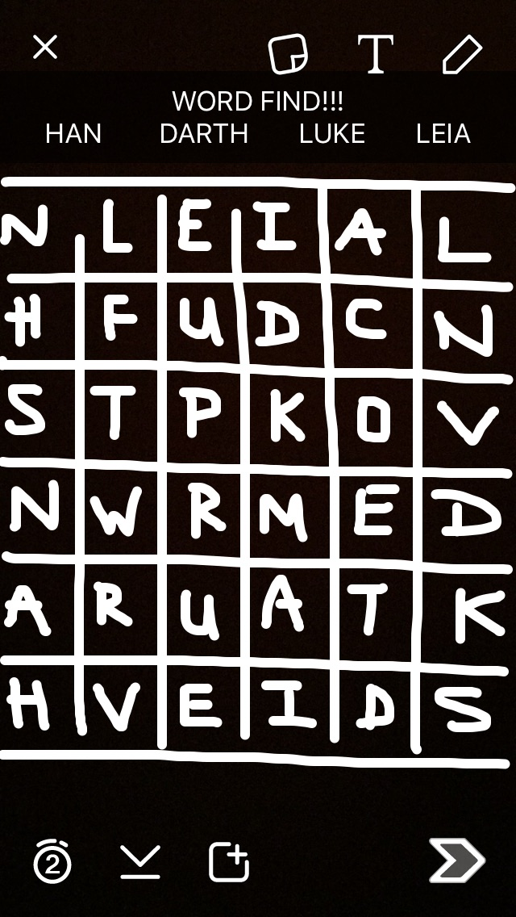
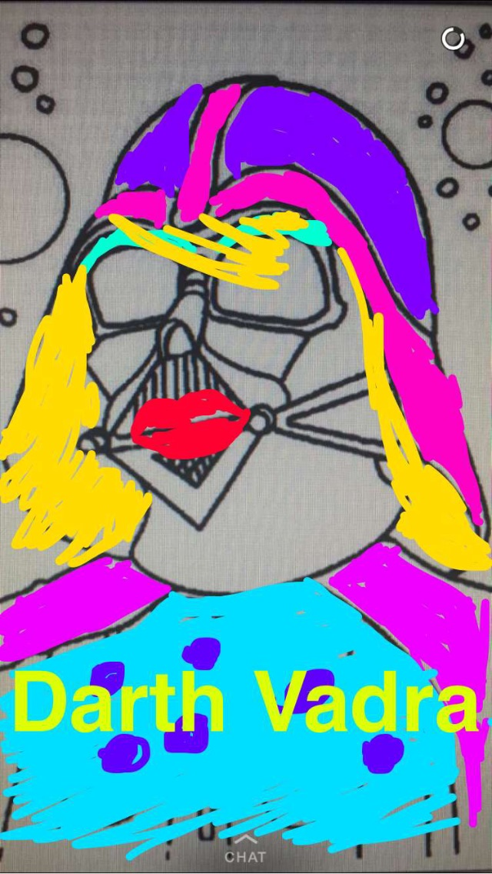
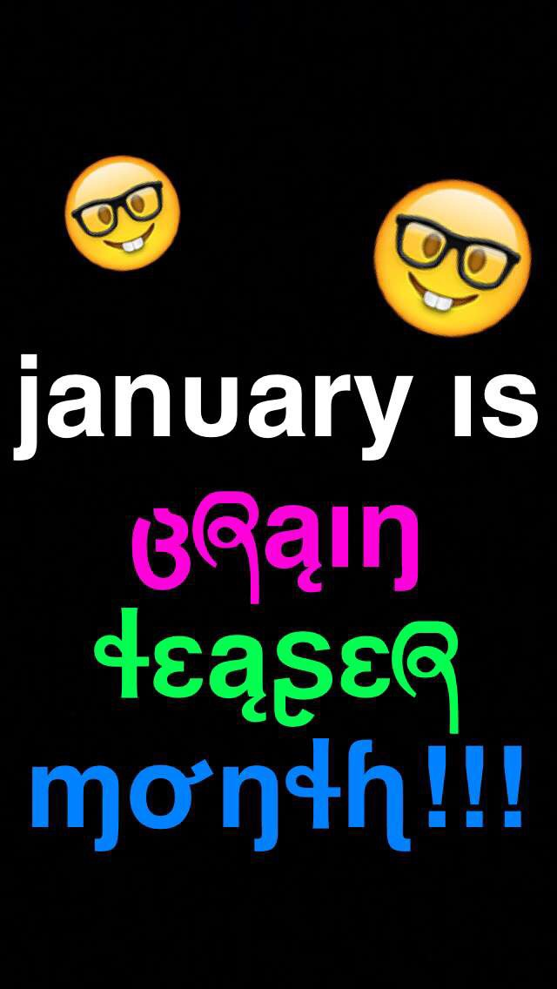
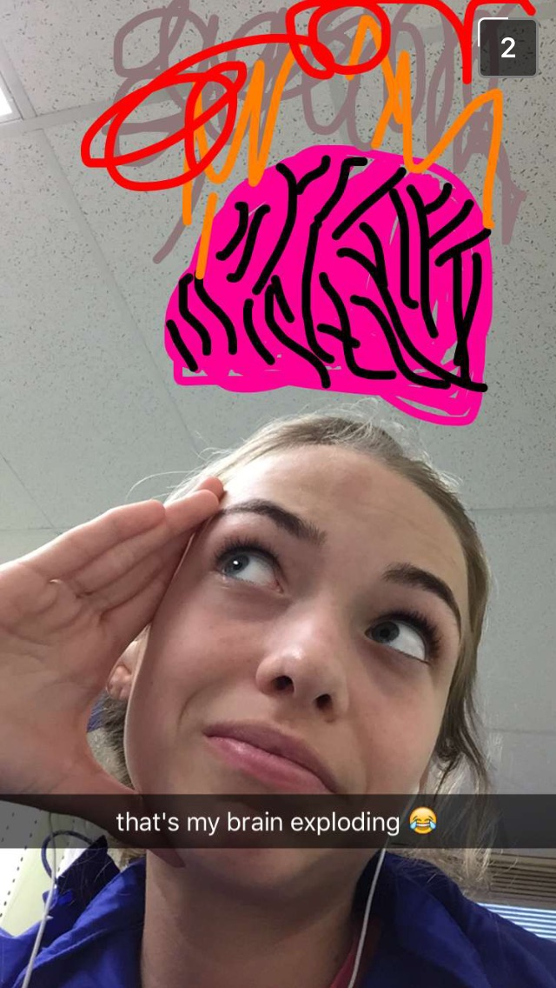
Create with variety (aka, challenge yourself)

Slide 16
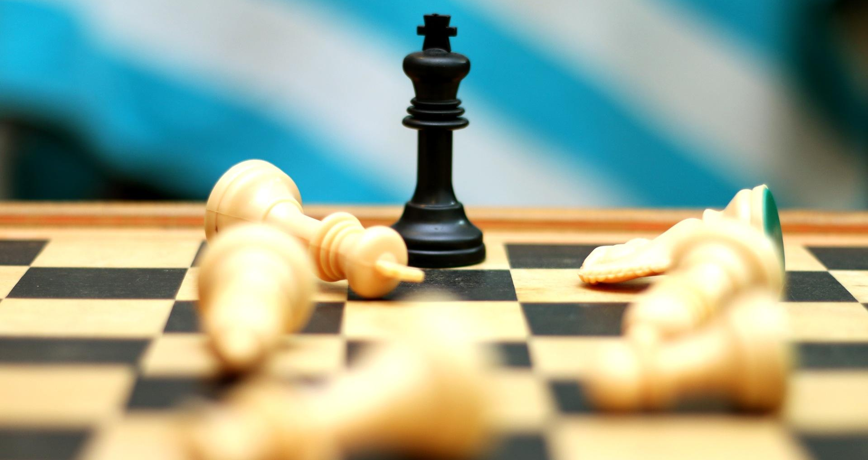
3. A piece of your digital strategy
Aka, pay the right attention
@sammyragland #ONASouthFlorida

Slide 17
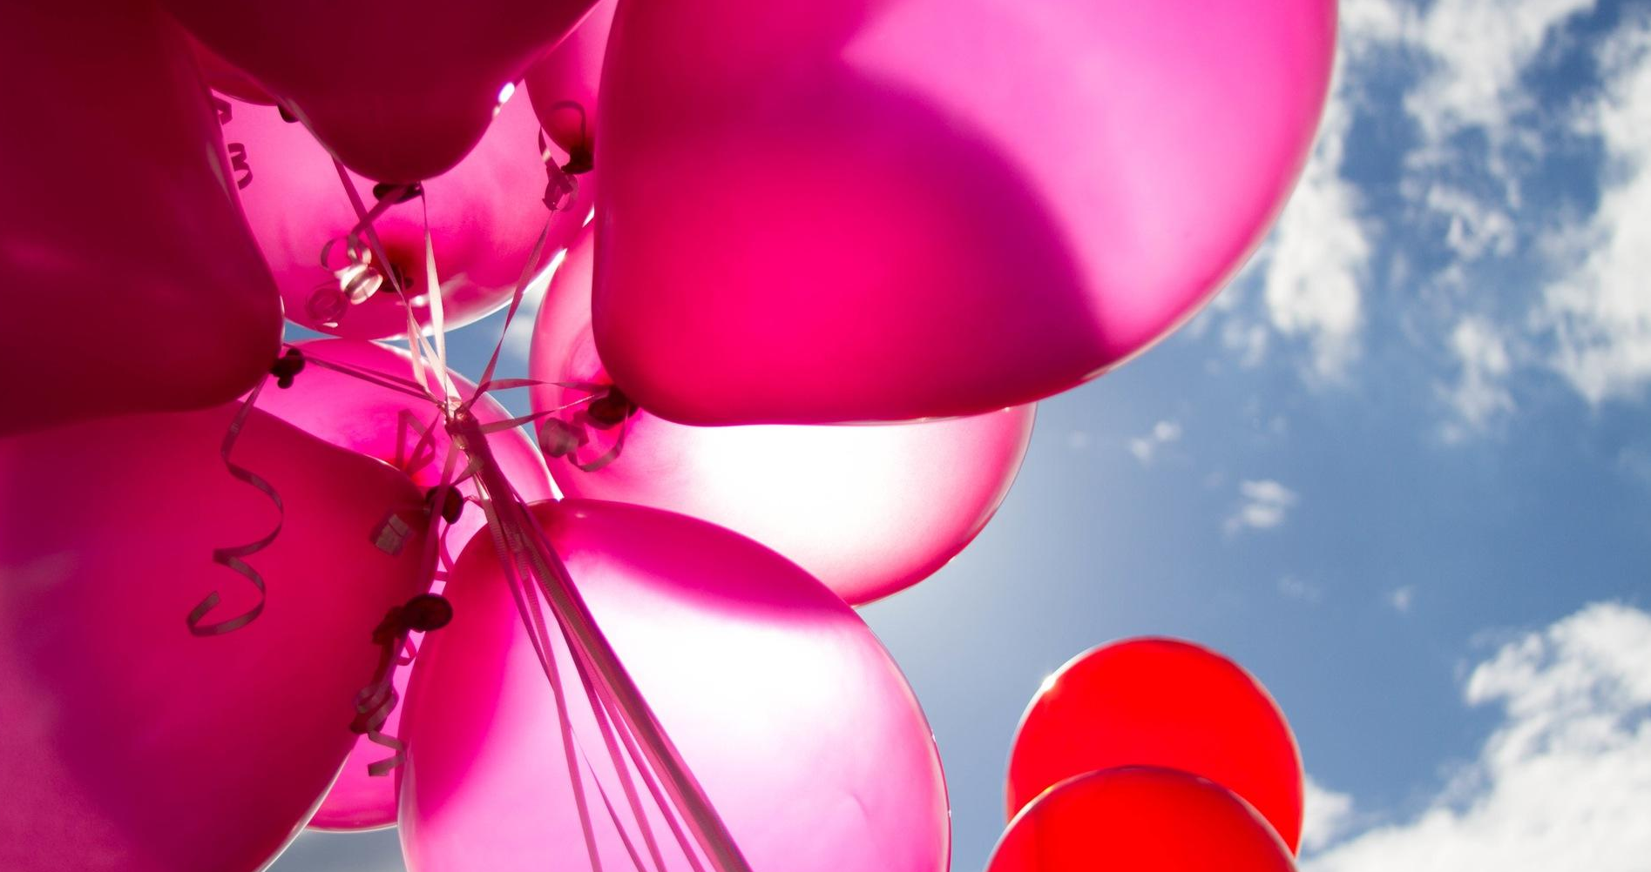
A Snapchat story should be able to stand alone… but can be a triple win if it brings in new audience while complementing traditional content.
@sammyragland #ONASouthFlorida

Slide 18
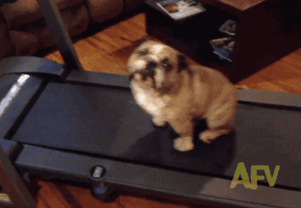
Pay attention to your audience
Did viewer retention drop dramatically?
Snap fatigue is real.
@sammyragland #ONASouthFlorida

Slide 19
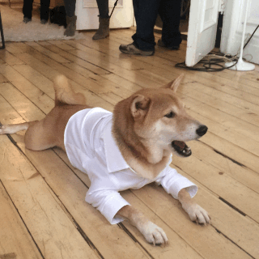
Pay attention to your audience
Are your snaps becoming wallpaper?
Snap redundancy is not hot.
@sammyragland #ONASouthFlorida

Slide 20
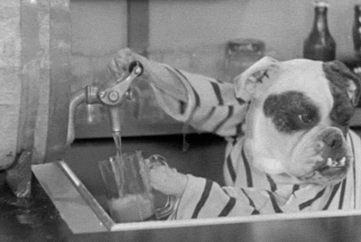
Pay attention to your audience
How creative is your work?
Snap influencers are free inspiration.
@sammyragland #ONASouthFlorida

Slide 21
To snap or not to snap?
@sammyragland #ONASouthFlorida

Slide 22
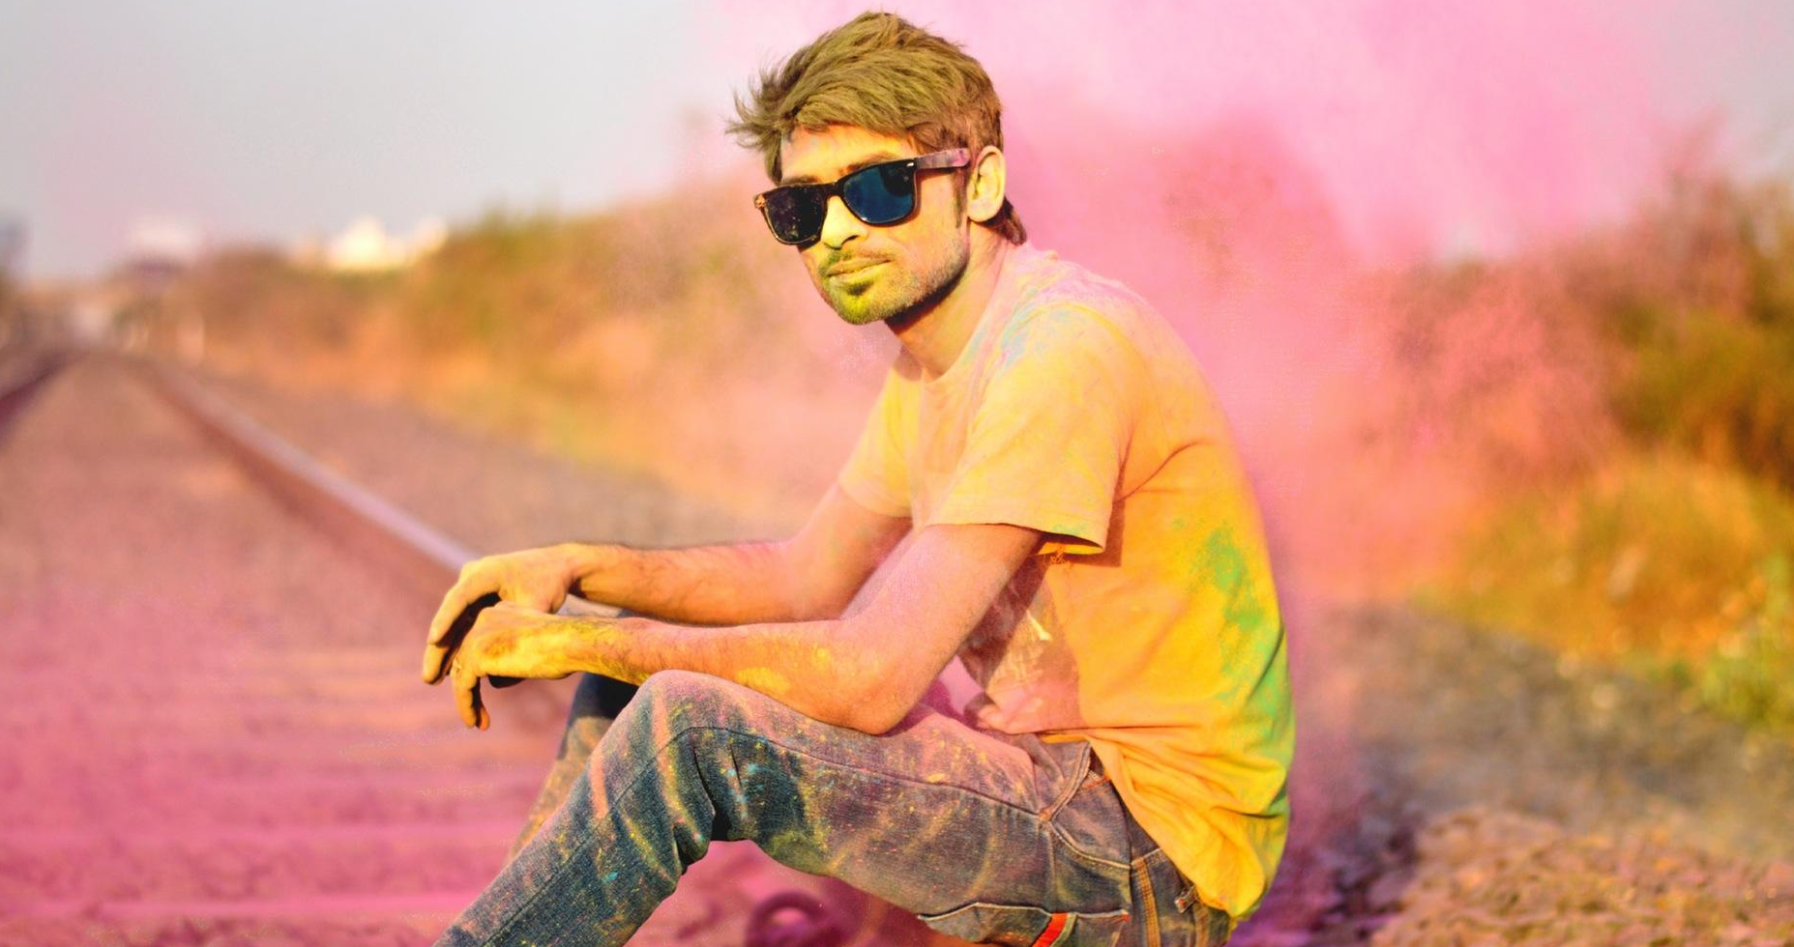
Pay attention to your story choices
Does this story provide something?
Information, humor, encouragement
Is the story visually dynamic?
Colorful, physically moving, human
Will this story be engaging?
Honest, transparent, two-way
Will this story adhere to snap-style?
Seconds, emojis, skimmable text

Slide 23
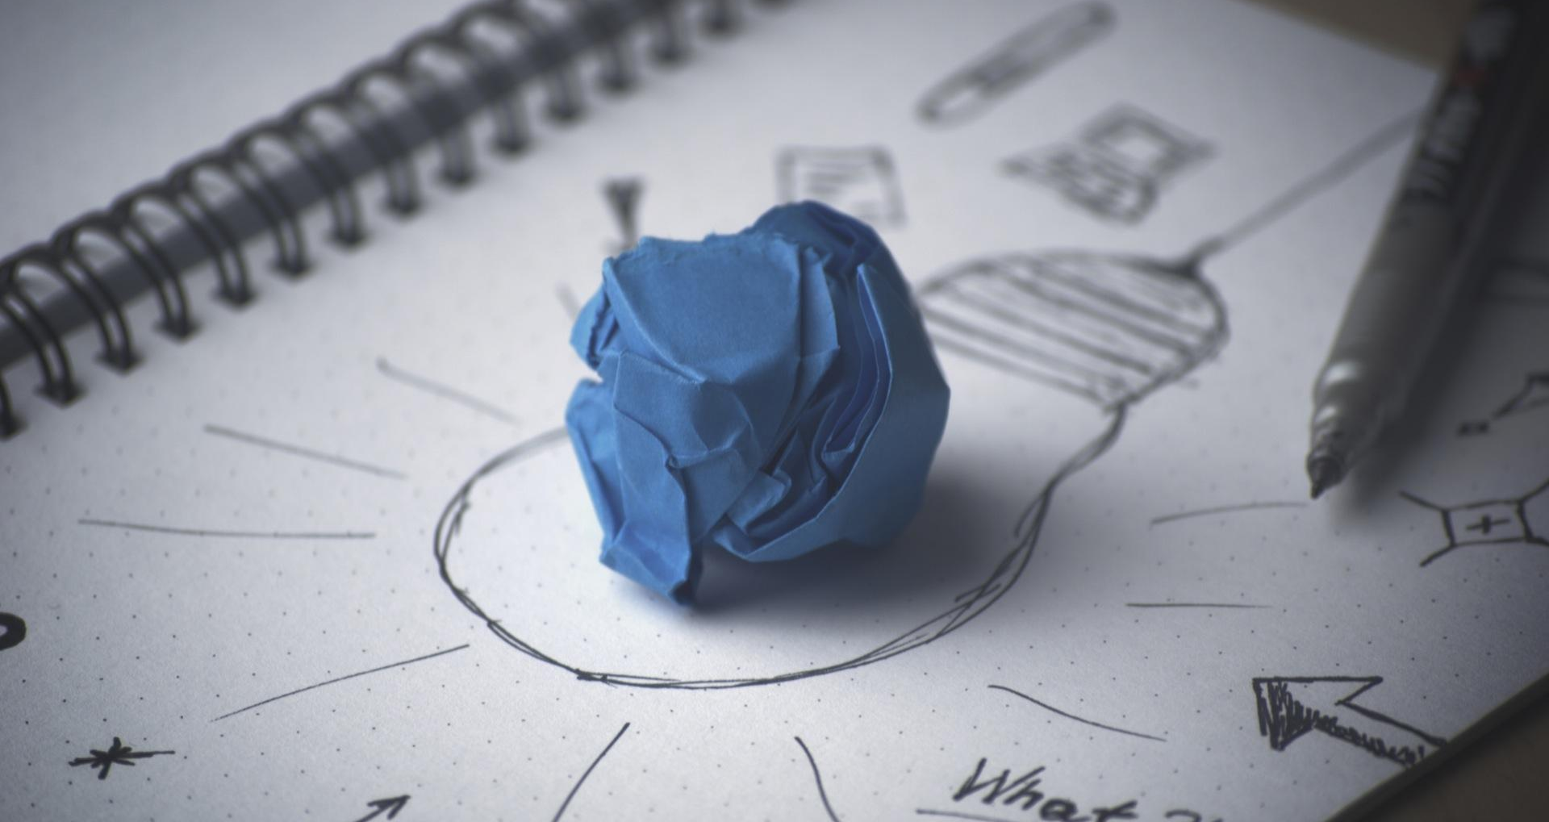
4. Brainstorm time!
Aka, practice before you preach
@sammyragland #ONASouthFlorida

Slide 24
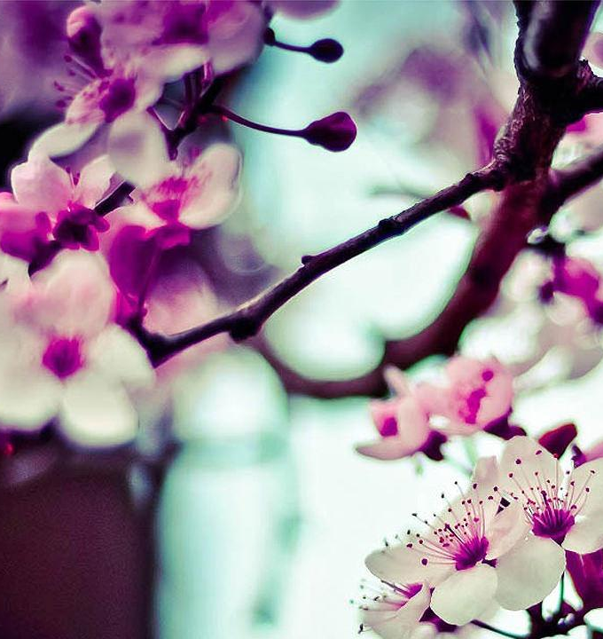
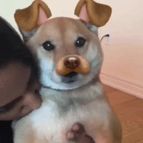
Snap Game -- Respected.
Any
Questions???
View this deck later: pbpo.st/onalocalsnapdeck
@sammyragland #ONASouthFlorida

